Slide 1

Visual Studio
Notes:
1

Slide 2
Why we need this presentation?
Sharpen your saw
Increase productivity
If you can save a little time from your codding efforts with Visual Studio then you can go home. Be with your family and do whatever you want to do.

Slide 3
Shortcuts for Visual Studio
Why learning shortcut is important
Amount of time you spend with Mouse will be less and you can use your both hands on keyboards only
At first, Mouse seems to be easier first but in longer term it will be your productivity loss.
Lots of time will be lost switching between Mouse and Keyboard.
Take example of Ctrl + S – A shortcut for saving document, files etc. If you don’t have that shortcut then imagine time you spent to save document!! You have to shift your hand from keyboard to mouse and need to find save icon and click on save.
It will well worth learning shortcut another way of doing things without using Mouse.

Slide 4
Common short cuts
Here are some of the common short cuts for visual studio just like another software.
Ctrl + S : To save current file
Ctrl + Shift + S: Save all files.
Ctrl + C : For copying code
Ctrl + V : For pasting copied code
Ctrl + 0 : Open file
Ctrl + Z : Undo changes
Ctrl + Y : Redo changes
Del: Deleting code
Ctrl + A : Select All.
Ctrl + F : Find in current document
Alt + F4: Close Visual studio.

Slide 5
File Menu and Solution Explorer shortcuts:
New Project Related short cuts:
Ctrl + Shift + N : Creating a new project
Shift + Alt + N : Creating a new website
Open Project Related short cuts:
Ctrl + Shift + O : Open Project
Shift + Alt + O : Open website
Solution Explorer Related Shortcuts:
Ctrl + Alt + L : Open Solution Explorer
Ctrl + Shift + A : Add new item in current project in solution explorer
Shift + Alt + A : Add existing item in current project of solution explorer

Slide 6
Formatting techniques
Formatting document:
Ctrl+ K, Ctrl + D:Format document
Ctrl + K, Ctrl + F: Format Selection
Region Open and Close Short Cut
Ctrl + M, Ctrl + 0: Collapse All
Ctrl + M, Ctrl + L: Expand All
Ctrl + M, Ctrl + M: Collapse, Expand one
Comment and Uncomment Block:
Ctrl + K, Ctrl + C : Comment block
Ctrl + K, Ctrl + U : Uncomment block

Slide 7


Formatting techniques
Increase Decrease Indentation of a block of code
To select block press Shift + Down + Arrow
Select block and Press Tab to indent a code.
Use Shift-Tab to Alter the indentation

Slide 8

Formatting techniques
Select a Rectangular Area of Text:
Hold Alt Down and drag mouse over text area you like to select.
Converting text into upper case and lower case:
Ctrl + Shift + U : Upper Case
Ctrl + U : Lower Case

Slide 9
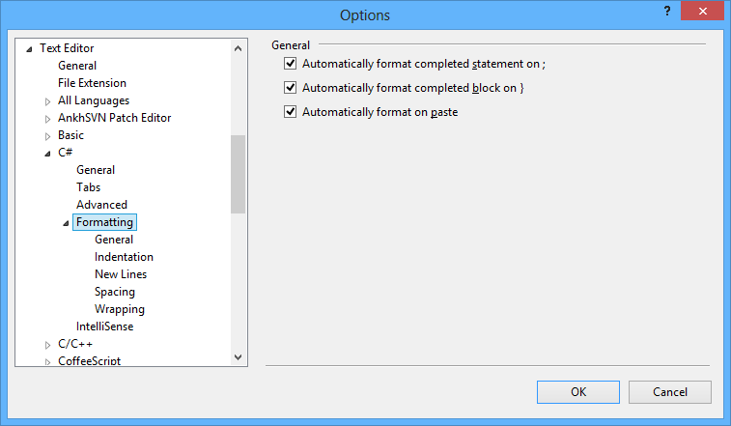
Formatting techniques
Formatting C# options:
You can set your own formatting options via Tools->Options->Text Editor->C# -> Formatting

Slide 10
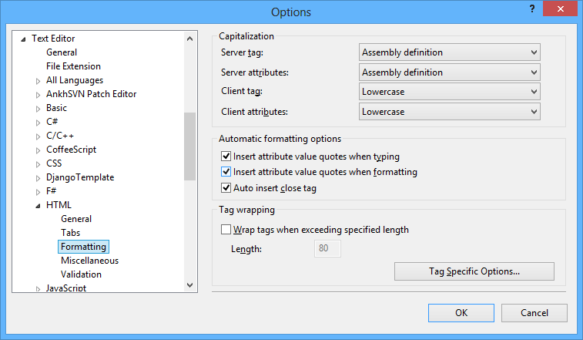
Formatting techniques
Formatting HTML options:
You can set your own formatting options via Tools->Options->Text Editor->HTML -> Formatting

Slide 11
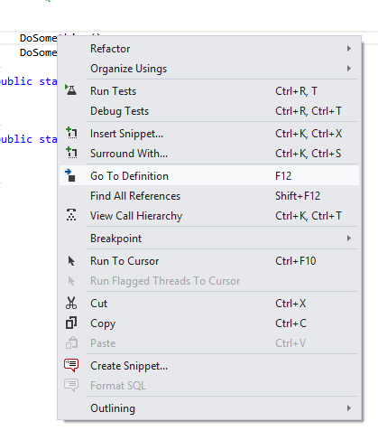
Formatting techniques
Go To Definition:
You can go to any variable, member, method in Visual Studio via Selecting Variable and right click and click on go to definition or pressing F12.

Slide 12
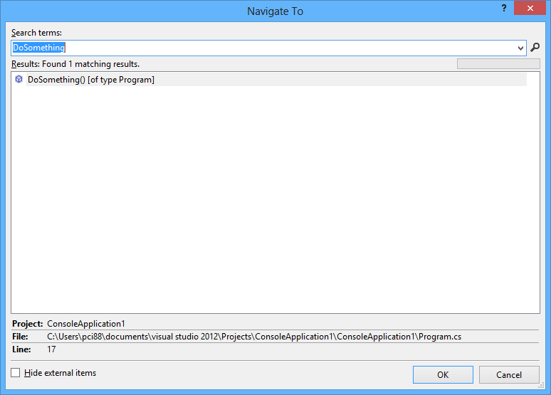
Navigation Techniques
Navigate To:
You can find any code with this Window. You can press Ctrl + Comma to open this window.
Notes:
12

Slide 13
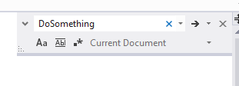
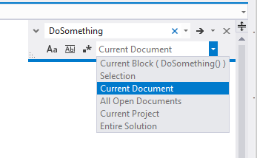
Searching Techniques(Navigation)
Find in Current document:
You can find any text with current document with Ctrl + F3.
Here you also have few options at bottom to find in selection, All Open Documents, Current Projects, Entire Solution
Notes:
13

Slide 14
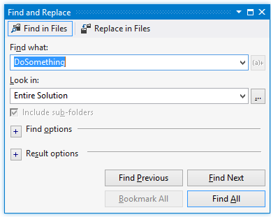
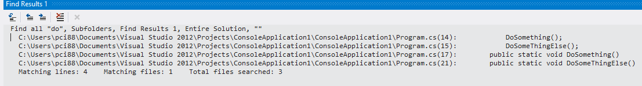
Searching Techniques(Navigation)
Find in Files:
There is also another way of findings text in files with Find in Files. You can find that via Ctrl + Shift + F. It will show results in find result window. Here also you can multiple options just like you have in normal find.
You can navigate to each via click on line of find results.
Notes:
14

Slide 15

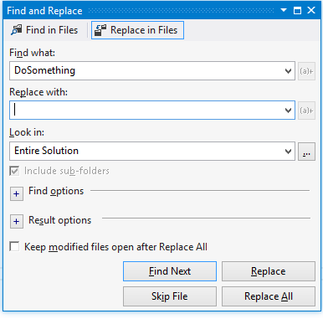
Searching Techniques(Navigation)
Replace:
Just like another software you can find and replace with find and find and find in files both options.
Notes:
15

Slide 16
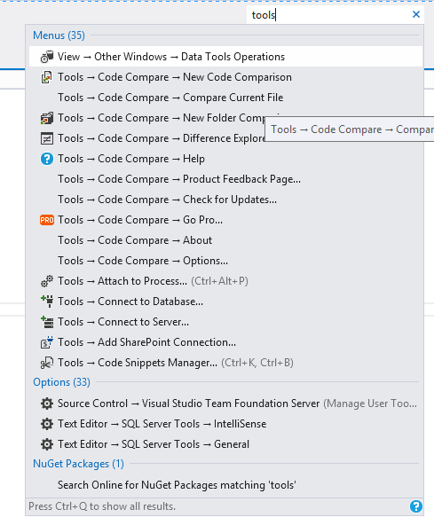
Searching Techniques(Navigation)
Quick Launch in Visual Studio:
At the top Visual Studio also have quick launch where you can quickly type particular command i.e. tools and perform
actions against it. Once you select command and press enter it will perform that action/command.
Notes:
16

Slide 17
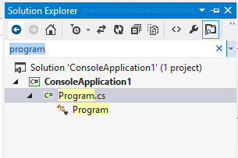
Searching Techniques(Navigation)
Solution Explorer find in files:
With Visual Studio 2012, You can find files in solution explorer also. This will come very handy when you have very large solution.
Notes:
17

Slide 18
Debugging Techniques
What is debugging:
In General Term, Debugging is a process of finding out defects in program and fix them.
In software development testing and defect fixing is very important and debugging is a kind of technique to walk through code and find problem with code.
Debugging allows you to quickly understand current code. So if you have code that is not created by you then debugging will help you understand code of other people.
Sometimes its takes time to find defects and If you know debugging techniques then you will able to find it very quickly.
Notes:
18

Slide 19
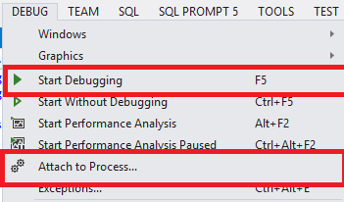
Debugging Techniques
Where to Start Debugging:
You can start debugging with Debug Menu of Visual Studio IDE via start debugging or pressing F5 Visual Studio.
Notes:
19

Slide 20


Debugging Techniques
Breakpoints:
Break points is used to notify Visual Studio Debugger where and when to pause the program.
You can put break points via click on particular line on left side bar of visual studio or via pressing F9.
Once break point will hit it will show yellow line there.
Notes:
20

Slide 21


Debugging Techniques
Step Over(F10):
After break points hits you need to execute code side by side. Step Over(F10) command is used to execute code line by line.
Step into(F11):
This is similar to step over the only difference is when it is a method it will go inside method.
Notes:
21

Slide 22

Debugging Techniques
Step Out(Shift + F11):
This is related to when you are debugging inside a method. If you press Shift + F11 it will complete execution of current method and execution will pause at next statement after that method call.
Continue(F5):
You can also continue the program flow until you reach next process.
Notes:
22

Slide 23
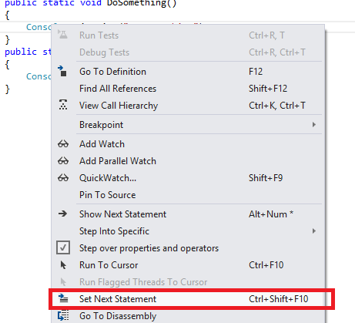
Debugging Techniques
Set Next Statement(Ctrl + Shift + F10):
This is quite a interesting feature.
Set Next Statement allows change the path of execution while you are debugging.
You can set next statement via selecting statement and right click and click on Set Next Statement or pressing Ctrl + Shift + F10
Notes:
23

Slide 24


Debugging Techniques
Data Tip:
Data tip is kind of advance tool tip message which is used to inspect the object variables during debugging of the application. When debugger hits the break points, If you mouse over any variable you can see their current values.
You can also pin this data tip so that you don’t have to mouse hover every time.
Notes:
24

Slide 25
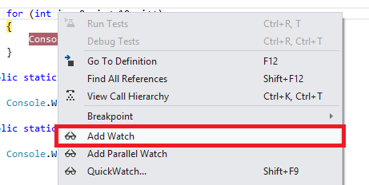
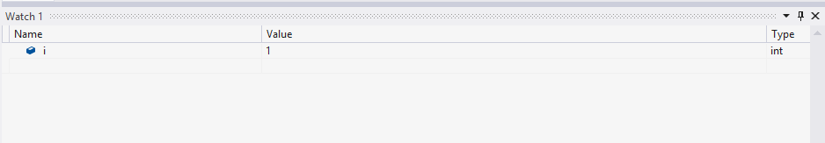
Debugging Techniques
Watch Window:
You can say it’s an investigation window. If you want to continue look into values of objects, variable you can add watch for them and that will show in watch window when you debug your code.
You can select any variable/object and click on add watch.
Notes:
25

Slide 26
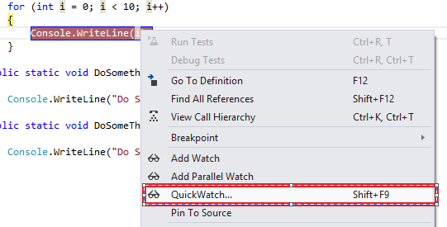
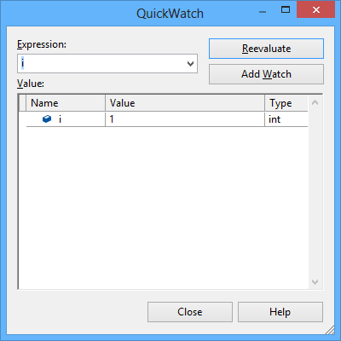
Debugging Techniques
Quick Watch(Shift + F9):
It’s an quick investigation windows. Similar to watch window but it will quickly enable to view values of current object.
Notes:
26

Slide 27
Version Control(SVN)
Why we need version control:
A version control remembers the history of your files. If you stuff something up you can get earlier version.
Made a mistake in code and realize it was a mistake and wanted to revert back.
Lost code or had a backup that was too old.
Wanted to see difference between two versions of your code.
Wanted to review history of some code.
Wanted to see how much work is being done, and where, when and by whom?
Wanted to work with multiple people in same code. Need to merge code in some other people’s code.
Wanted to merge code of other people in my module.
Notes:
27

Slide 28
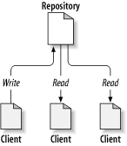
Version Control(SVN)
What is Repositories:
Repository is a central code base for a particular project.
It is a core part of SVN and central store of the SVN.
Repository usually stores information in the form of a file system tree – a hierarchy of files and directories.
Any number of clients connect to the repository, and then read or write to these files.
By writing data, a client makes the information available to others; by reading data, the client receives information from others.
Notes:
28

Slide 29
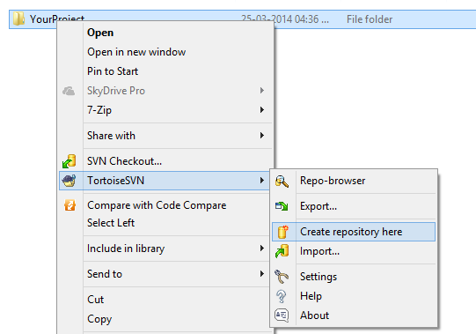
Version Control(SVN)
Creating Repositories:
We are using Tortoise SVN to for SVN.
Generally this will be on a server where everybody will have limited rights.
You can create repositories via right click on folder and from Tortoise SVN -> Create Repository Here.
Notes:
29

Slide 30
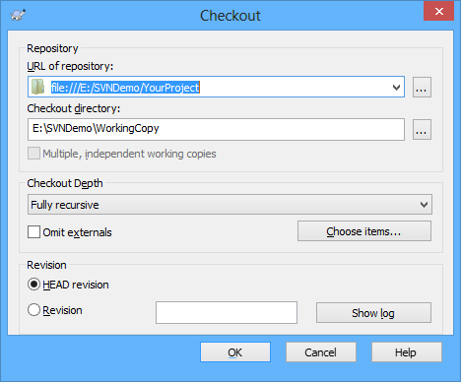
Version Control(SVN)
Working Copy:
A SVN working copy is a directory tree on a local system that looks like any other ordinary directory full of files, but it provides a developer with their own private work area, complete with copies of the files contained within the repository.
It will create a same replica of SVN repository on the developer’s machine.
You can create it via selecting folder SVN Checkout then it will ask for repository path once you provide repository path it will create a working copy.
Notes:
30

Slide 31
Version Control(SVN)
SVN Commands:
You can perform following command to working copy.
Commit: Sends changes from your working copy to the repository. Log messages can be added with either the –file or –message switch. You can perform this operator it self from the Visual Studio
Update: Updates your working copy with changes from the repository. The –revision switch can be used to provide a revision, or a range of revisions, to be updated to. If no revision is specified, this command brings your working copy into line with the HEAD (i.e the latest) revision. You can perform this operator it self from the Visual Studio
Notes:
31

Slide 32
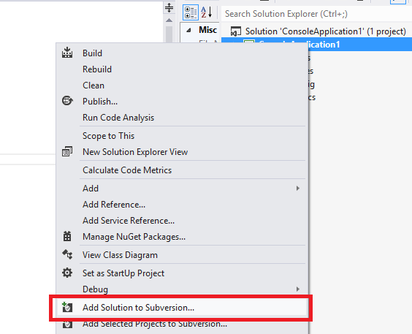
Version Control(SVN)
Adding Project to Source Control:
We using Ankh SVN for SVN Integration with Visual Studio. Once you install and integrate it. You can add project to source control via right click on Project-> Add solutions to Version Control
Notes:
32

Slide 33
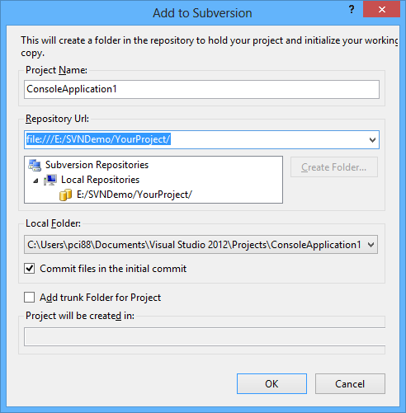
Version Control(SVN)
Adding Project to Source Control:
Once you click on that. It will open a window asking for SVN Repository details.
Notes:
33

Slide 34
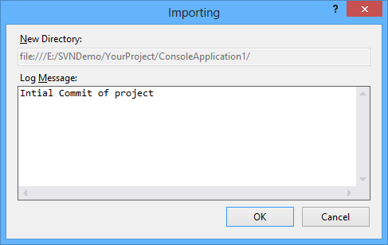
Version Control(SVN)
Adding Project to Source Control:
Once you click ‘OK’ it will ask for log message. Once you provide log message it will commit your project to SVN repository.
Notes:
34

Slide 35
Thank You
Notes:
35

